Slide 1
How to use SharePoint Online Management Shell
Speaker Name

Slide 3
Objective
After completing this lesson, you will be able to:
Describe what the SharePoint Online Management Shell is and where to find it.
Describe how to set up the SharePoint Online Management Shell environment and connect to the SharePoint Online service.
Describe how to use the SharePoint Online Windows PowerShell module to manage a SharePoint Online tenant.

Slide 4
Using the SharePoint Online Management Shell

Slide 5
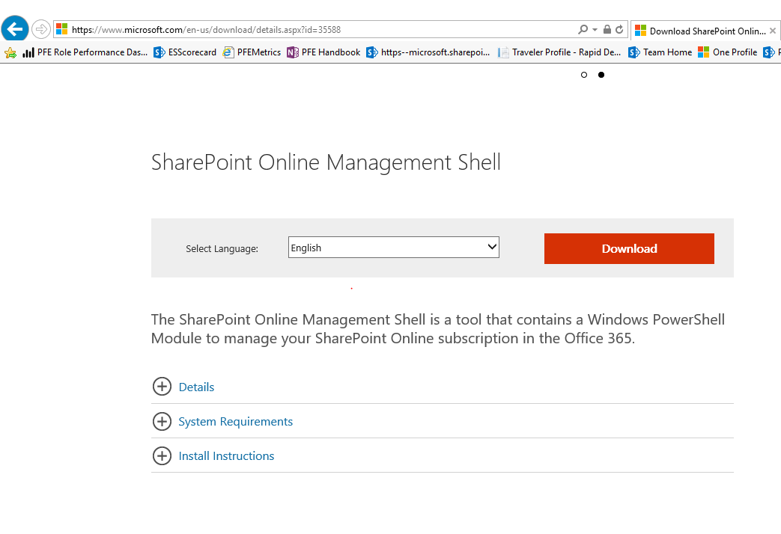
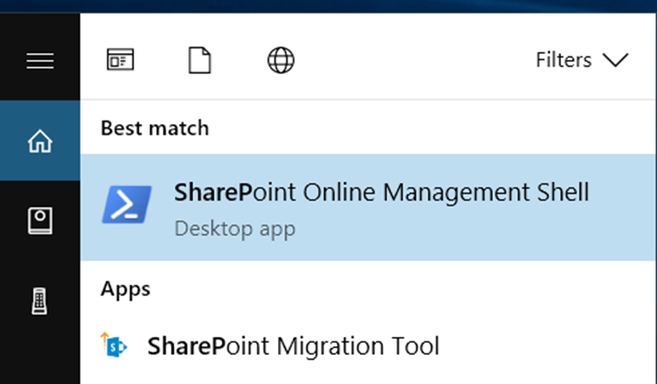
Obtaining SharePoint Online Management Shell
Perform an Internet search for Download SharePoint Online Management Shell
Download and Run as Administrator
The SharePoint Online Management Shell can also be installed using PSGet (Recommendation is to get latest version on regular basis to get new cmdlets)
Install-Module -Name Microsoft.Online.SharePoint.PowerShell
See https://docs.microsoft.com/en-us/powershell/sharepoint/sharepoint-online/connect-sharepoint-online?view=sharepoint-ps
Notes:
http://www.microsoft.com/en-us/download/details.aspx?id=35588
System Requirements
Windows 10 , Windows 7 Service Pack 1, Windows 8, Windows Server 2008 R2 SP1, Windows Server 2008 Service Pack 2, Windows Server 2012, Windows Server 2016
PowerShell 3.0
The SharePoint Online Management Shell can also be installed using PSGet
Install-Module -Name Microsoft.Online.SharePoint.PowerShell
See https://docs.microsoft.com/en-us/powershell/sharepoint/sharepoint-online/connect-sharepoint-online?view=sharepoint-ps

Slide 6
Connect and Disconnect to SPOService
Connect-SPOService
Connect-SPOService -Url https://contoso-admin.sharepoint.com
Disconnect-SPOService
Disconnect-SPOService
Notes:
The Disconnect-SPOService cmdlet explicitly disconnects a previously created SharePoint Online service connection.
Global administrators can disconnect the service by running the Disconnect-SPOService cmdlet or by running the Connect-SPOService cmdlet to initiate another connection. For more information, see Connect-SPOService.
Even after a connection is terminated, operations that were started before the connection is terminated will run to completion. In other words, long-running operations will not be terminated by running the Disconnect-SPOService cmdlet

Slide 7
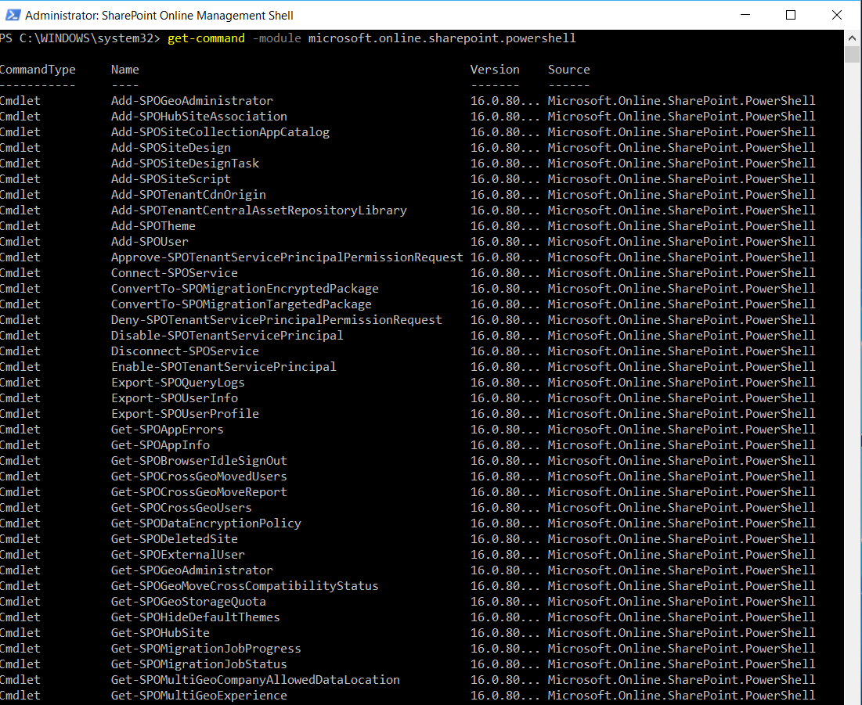
SharePoint Online Management Shell Cmdlets
Get-Command –Module Microsoft.Online.SharePoint.PowerShell
Notes:
There are more commands than what you can see from this view

Slide 8
User Account Management
Add-SPOUser
Add-SPOUser -Site https://contoso.sharepoint.com/sites/marketing -LoginName joe.healy@contoso.com -Group "SC1 Owners"
Get-SPOUser
Get-SPOUser -Site https://contoso.sharepoint.com/sites/marketing -Group "Team Site Members“
Remove-SPOUser
Remove-SPOUser -Site https://contoso.sharepoint.com/sites/marketing -LoginName joe.healy@contoso.com -Group "SC1 Owners”
You must be a SharePoint Online admin.
Set-SPOUser
Set-SPOUser -Site https://contoso.sharepoint.com/sites/marketing -LoginName melissa.kerr@contoso.com -IsSiteCollectionAdmin $true

Slide 9
External User Management
Get-SPOExternalUser
Get-SPOExternalUser -Position 0 -PageSize 30 -Filter @testsite.com
Remove-SPOExternalUser
$user = Get-SPOExternalUser -Filter someone@example.com
You must be a SharePoint Online admin.
Remove-SPOExternalUser -UniqueIDs @($user.UniqueId)
Notes:
The Get-SPOExtrenalUser cmdlet returns external users that are located in the tenant based on specified criteria.
The Remove-SPOExternalUser cmdlet permanently removes a collection of external users from the tenant.
For example Get-SPOExternalUser -Position 2 -PageSize 2 returns two external users from the third page of the collection.

Slide 10
SharePoint Site Group Management
Get-SPOSiteGroup
Get-SPOSiteGroup -Site http://contoso.sharepoint.com/sites/marketing
New-SPOSiteGroup
New-SPOSiteGroup -Site https://contoso.sharepoint.com/sites/marketing -Group "Project Leads" -PermissionLevels "Full Control"
Remove-SPOSiteGroup
Remove-SPOSiteGroup –Site https://contoso.sharepoint.com/sites/marketing -Identity GroupToRemove
Set-SPOSiteGroup
Set-SPOSiteGroup -Site http://contoso.sharepoint.com/sites/marketing -Identity "Project Leads" -PermissionLevelsToRemove "Full Control" -PermissionLevelsToAdd "View Only“
You must be a SharePoint Online admin.
Notes:
Get-SPOSiteGroup: Gets all the groups on the specified site collection.
New-SPOSiteGroup: Creates a new group in a SharePoint Online site collection.
Remove-SPOSiteGroup: Removes a SharePoint Online group from a site collection.
Set-SPOSiteGroup: Updates the SharePoint Online owner and permission levels on a group inside a site collection.

Slide 11
Site Collection Management
Get-SPODeletedSite
Get-SPODeletedSite -Identity http://contoso.sharepoint.com/sites/marketing
Restore-SPODeletedSite
Restore-SPODeletedSite -Identity https://contoso.sharepoint.com/sites/marketing
Remove-SPODeletedSite
Remove-SPODeletedSite -Identity https://contoso.sharepoint.com/sites/marketing
Get-SPOSite
Get-SPOSite –Filter {Url -like “*term*”} | Ft Url
Get-SPOSite | ft Url, CompatibilityLevel
Valid operators are as follows: EQ, NE, LIKE, NOTLIKE
Notes:
Restore a Deleted Site Collection
The Recycle Bin in SharePoint Online for Enterprises provides a safety net when an entire site collection is deleted. When a SharePoint Online Administrator deletes a site collection, it is placed in the Recycle Bin, where it is kept for 30 days, before it is automatically deleted permanently.
The Get-SPODeletedSite cmdlet returns all deleted site collections that match the given criteria from the Recycle Bin.
You must be a SharePoint Online global administrator and a site collection administrator for the deleted site collections to run the cmdlet.
The Restore-SPODeletedSite cmdlet restores a SharePoint Online deleted site collection from the Recycle Bin.
The Remove-SPODeletedSite cmdlet permanently removes a SharePoint Online deleted site collection from the Recycle Bin.
You have to be a SharePoint Online global administrator and site collection administrator permissions to run the cmdlet.
The Get-SPOSite cmdlet contains more than one parameter set. You may only use parameters from one parameter set, and you may not combine parameters from different parameter sets.
For more information about how to use parameter sets, see Cmdlet Parameter Sets - http://msdn.microsoft.com/en-us/library/dd878348(VS.85).aspx.
The Get-SPOSite cmdlet retrieves and returns properties of all site collections that match the given criteria.
Note: Site collections in the Recycle Bin will not be retrieved by using the Get-SPOSite cmdlet.
You need to be a SharePoint Online global administrator and a site collection administrator to run the cmdlet.
The New-SPOSite cmdlet creates a new site collection for the current company. However, if a deleted site with the same URL exists in the Recycle Bin, creating a new SharePoint Online site collection fails.
You must be a SharePoint Online global administrator to run the cmdlet.
The Remove-SPOSite cmdlet does not delete a site collection from the site collections list permanently. Instead, the removed site collection is moved to the Recycle Bin. You can use the Restore-SPODeletedSite cmdlet to restore a site collection from the Recycle Bin. To delete a site collection permanently, first move the site collection to the Recycle Bin by using the Remove-SPOSite cmdlet, and then delete it from the Recycle Bin by using the Remove-SPODeletedSite cmdlet.
You must be a SharePoint Online global administrator and a site collection administrator to run the cmdlet.
The Repair-SPOSite cmdlet runs one or all site collection health checks on the site collection and its contents. This cmdlet will make changes, if issues are found and automatically repairable.
The cmdlet reports the health check rules with a summary of the results. The rules might not support automatic repair.
Tests without repair mode can be initiated by running the Test-SPOSite cmdlet.
You must be a SharePoint Online global administrator to run the cmdlet.

Slide 12
Creating Site Collections
New-SPOSite
Must use the pre-set managed paths (/sites or /teams) available in SharePoint Online :
-Url: Full URL of the site collection (remember to use https)
-Owner: Full user name of site owner (that is admin@mytenant.onmicrosoft.com)
-StorageQuota: In MB
-Template: (Optional) for example STS#3 Use Get-SPOWebTemplate to view a list of available templates
-Title: (Optional) Name of the site collection
-NoWait: Instructs Windows PowerShell not to wait until the cmdlet is finished
New-SPOSite -Url https://mytenant.sharepoint.com/sites/sitename -Owner "admin@mytenant.onmicrosoft.com" -StorageQuota "500" -NoWait -Template "STS#3" -Title "Site Title"
Notes:
NOTE: The STS#3 template is used to provision a modern site collection that is not connected to an Microsoft 365 Group
If the -template parameter is not defined, the Blank site template will be used, and a site template will need to be selected once the site is accessed.
The New-SPOSite cmdlet creates a new site collection for the current company. However, creating a new SharePoint Online site collection fails, if a deleted site with the same URL exists in the Recycle Bin.
You must be a SharePoint Online global administrator to run the cmdlet.
If no template is specified, one can be selected later.
Name Title LocaleId CompatibilityLevel
---- ----- -------- ------------------
STS#3 Team site 1033 15
STS#0 Team site (classic experience) 1033 15
BLOG#0 Blog 1033 15
BDR#0 Document Center 1033 15
DEV#0 Developer Site 1033 15
OFFILE#1 Records Center 1033 15
EHS#1 Team Site - SharePoint Online configuration 1033 15
BICenterSite#0 Business Intelligence Center 1033 15
SRCHCEN#0 Enterprise Search Center 1033 15
BLANKINTERNETCONTAINER#0 Publishing Portal 1033 15
ENTERWIKI#0 Enterprise Wiki 1033 15
PROJECTSITE#0 Project Site 1033 15
PRODUCTCATALOG#0 Product Catalog 1033 15
COMMUNITY#0 Community Site 1033 15
COMMUNITYPORTAL#0 Community Portal 1033 15
SITEPAGEPUBLISHING#0 Communication site 1033 15
SRCHCENTERLITE#0 Basic Search Center 1033 15
visprus#0 Visio Process Repository 1033 15

Slide 13
Configuring Site Collections
Set-SPOSite -Identity (URL of site collection)
SharingAllowedDomainList SharingBlockedDomainList
DisableCompanyWideSharingLinks
DisableSharingForNonOwners
Owner
StorageQuota
StorageQuotaWarningLevel
Title
SharingCapability
Notes:
For any parameters that are passed in, the Set-SPOSite cmdlet sets or updates the setting for the site collection, identified by parameter identity.
You must be a SharePoint Online global administrator and a site collection administrator to run the cmdlet.

Slide 14
SharePoint Online Tenant Level Management
Get-SPOTenant
Set-SPOTenant –ShowEveryoneClaim
Set-SPOTenant -ShowEveryoneClaim $false This example hides the "Everyone Except External Users" claim in People Picker.
Returns organization-level site collection properties such as StorageQuota, StorageQuotaAllocated, SharingCapability, LegacyAuthProtocolsEnabled, and SiteCreationMode

Slide 15
SharePoint Online Tenant Level Management (continued)
Add-SPOTenantCdnOrigin
Use the Add-SPOTenantCdnOrigin cmdlet to define a site collection as a private origin within the Microsoft 365 CDN
Add-SPOTenantCdnOrigin -CdnType Private -OriginUrl sites/site1/siteassets
Set-SPOTenantCdnEnabled
Enables or disables Public content delivery network (CDN) or Private CDN on the tenant level. Set-SPOTenantCdnEnabled -CdnType <Public | Private | Both> -Enable $true
Set-SPOTenant -LegacyAuthProtocolsEnabled
By default this value is set to $True.
A value of $False-Prevents Office clients using non-modern authentication protocols from accessing SharePoint Online resources.
This may also prevent third-party apps from accessing SharePoint Online resources
This will also block apps using the SharePointOnlineCredentials class to access SharePoint Online resources.
Notes:
The Get-SPOTenant cmdlet returns organization-level site collection properties, such as StorageQuota, StorageQuotaAllocated, ResourceQuota, ResourceQuotaAllocated, and SiteCreationMode.
You must be a SharePoint Online global administrator to run the cmdlet
The Get-SPOTenantLogEntry cmdlet cannot retrieve all the SharePoint Online errors. This cmdlet retrieves a subset of errors that happen due to external systems.
Note: If you do not use any parameter, the first 1000 rows in descending time range are returned.
You must be a SharePoint Online global administrator to run the cmdlet
The Get-SPOWebTemplate cmdlet displays all site templates that match the given identity and are available in SharePoint Online.
You must be a SharePoint Online global administrator to run the cmdlet.
The Get-SPOTenant cmdlet returns organization-level site collection properties, such as StorageQuota, StorageQuotaAllocated, ResourceQuota, ResourceQuotaAllocated, and SiteCreationMode.
You must be a SharePoint Online global administrator to run the cmdlet.

Slide 16
SharePoint Online Tenant Level Management (continued)
Get-SPOTenantSyncClientRestriction
Returns whether the property is True or False
Remove-SPOTenantSyncClientRestriction
Disables existing sync client restrictions that are in place at the tenant level
Note: May take up to 24 hours for change to take effect
Set-SPOTenantSyncClientRestriction
Set-SPOTenantSyncClientRestriction -Enable -DomainGuids "786548DD-877B-4760-A749-6B1EFBC1190A; 877564FF-877B-4760-A749- 6B1EFBC1190A”
Note: Allows you to set domain GUIDs for the safe recipients list in the OneDrive for Business sync operation
Notes:
The Get-SPOTenantSyncClientRestriction cmdlet returns whether the TenantRestrictionEnabled property is true or false, and it returns DomainGUIDs that are currently in the safe recipient list which is represented by the AllowedDomainList property.
The Set-SPOTenantSyncClientRestriction cmdlet enables the feature for tenancy and sets the domain GUIDs in the safe recipients list. When this feature is enabled, it can take up to 24 hours for the change to take effect. However, any changes to the safe recipients list are reflected within five minutes.
When this feature is enabled, the following will occur:
All OneDrive for Business sync client requests originating from a domain that is not on the safe recipients list will be blocked.
All OneDrive for Business Mac Sync client requests will be blocked.
Mobile clients are not blocked when this feature is enabled.
Regardless of whether a computer is managed by a device management solution, a sync relationship will not be established unless they are joined to a domain in the Safe Recipient List.
Any files that have been previously been synced down to your computer will not be deleted.
You need to be aware of the following upload behavior:
New or existing files added to the client will still be uploaded to the server and will not be blocked.
Regardless of whether the computer is joined to a domain that is set in the Safe Recipient List.
Regardless of whether the computer is joined to a domain that is not set in the Safe Recipient List.
For all non-domain joined computers.
OneDrive for Business sync client prior to version 15.0.4693.1000 will stop syncing existing libraries.
The Remove-SPOTenantSyncClientRestriction cmdlet disables the feature for tenancy, but does not remove any present domain GUID entries from the safe sender recipient list. After the Remove-SPOTenantSyncClientRestriction cmdlet is run, it can take up to 24 hours for the change to take effect.

Slide 17
Managing Tenant Level External User Access
Use Set-SPOTenant to configure External User Sharing settings at the SPO tenant level
Set-SPOTenant –SharingCapability
Disabled – External user sharing (share by email) and guest link sharing are both disabled
ExternalUserSharingOnly – External user sharing (share by email) is enabled, but guest link sharing is disabled
ExternalUserAndGuestSharing - External user sharing (share by email) and guest link sharing are both enabled
Set-SPOTenant –RequireAcceptingAccountMatchInvitedAccount
True or False
Ensures that an external user can only accept an external sharing invitation with an account matching the invited email address
Administrators who desire increased control over external collaborators should consider enabling this feature

Slide 18
Managing SPO Site Level External User Access
Use Set-SPOSite to configure External User Sharing settings on an SPO site
Set-SPOsite –Identity (site URL) -SharingCapability
Disabled – External user sharing (share by email) and guest link sharing are both disabled
ExternalUserSharingOnly – External user sharing (share by email) is enabled, but guest link sharing is disabled
ExternalUserAndGuestSharing - External user sharing (share by email) and guest link sharing are both enabled

Slide 19
Tenant Level External Sharing Domain Restriction
Use Set-SPOTenant to configure External Sharing domain restriction at the SPO tenant level
Set-SPOTenant –SharingDomainRestrictionMode
None – External sharing invitations can be sent to any email domain
AllowList – External sharing invitations can only be sent to email domains in the SharingAllowedDomainList
BlockList - External sharing invitations can not be sent to email domains in the SharingBlockedDomainList
Set-SPOTenant –SharingAllowedDomainList - specifies a list of email domains that is allowed for sharing with the external collaborators.
NOTE: Using the AllowList setting is the most restrictive The AllowList and BlockList settings cannot be used together.
Set-SPOTenant –SharingBlockedDomainList - specifies a list of email domains that are blocked or prohibited for sharing with the external collaborators.

Slide 20
Demonstration
SharePoint Online Management Shell
Notes:
Demonstrate the following:
To connect to SharePoint Online, use the Connect-SPOService command. It takes the URL to your tenant administrator and a username. When you connect, you will be prompted for your password.
Connect-SPOService –URL https://mytenant-admin.sharepoint.com– Credential admin@mytenant.onmicrosoft.com
To see what commands are available, you can use Get-Command and pass it the module Microsoft.Online.SharePoint.PowerShell.dll. For the full list, see the TechNet page: http://technet.microsoft.com/en-us/library/fp161364(v=office.15).aspx.
Get-Command –Module Microsoft.Online.SharePoint.PowerShell
Because Get-SPOSite uses Client-side Object Model (CSOM) under the hood and it does not request all values by default. To get this data, you need to add the –Detailed parameter.
Get-SPOSite –Detailed | ft Url, CompatibilityLevel
Get-SPOSite –Filter {Url -like “*term*”} | Ft Url
To delete a site collection, use Remove-SPOSite (TechNet page: http://technet.microsoft.com/en-us/library/fp161377(v=office.15).aspx) and pass it the URL in the Identity parameter. It can also optionally take the –NoWait parameter as well.
Remove-SPOSite –Identity https://mytenant.sharepoint.com/sites/sitename –NoWait
Deleted site collections get moved to the site collection recycle bin. To restore a site collection that you have deleted, use Restore-SPODeletedSite (TechNet page: http://technet.microsoft.com/en-us/library/fp161400(v=office.15).aspx). It takes the same parameters as Remove-SPOSite.
Restore-SPODeletedSite –Identity https://mytenant.sharepoint.com/sites/sitename –NoWait

Slide 21
Basic Windows PowerShell Commands
Get-Help
|FL - Format List
|FT - Format Table

Slide 22
Get-Help
Use the Get-help command to get help with other SharePoint Online commands.
Get-Help <command> –detailed
Provides the name, synopsis, syntax, description, related links, and remarks for the
For example: Get-help Get-SPOtenant –detailed

Slide 23
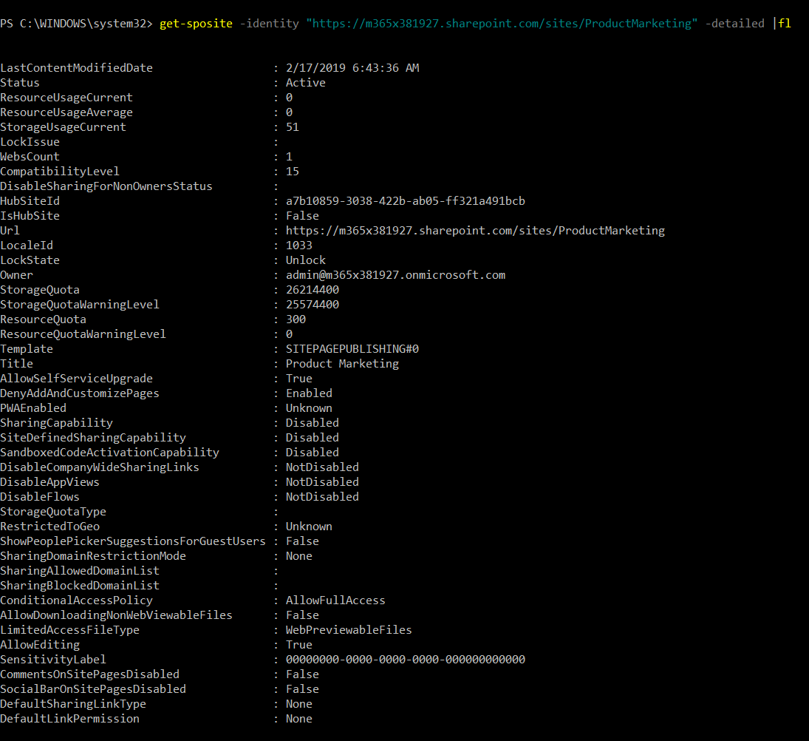
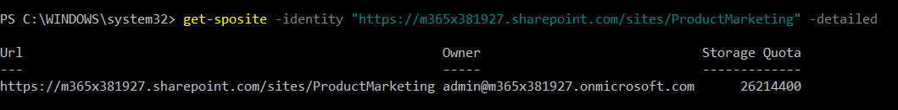
Using |FL to Format Output
Command without |FL parameter
Command with |FL parameter

Slide 24
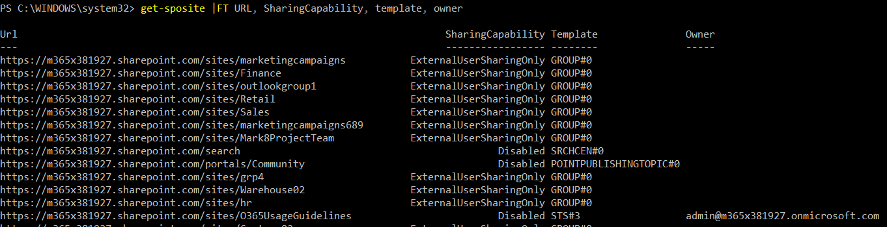
Using |FT to Format Output

Slide 25
Knowledge Check
Where can one obtain the SharePoint Online Management Shell?
What SharePoint Online Management Shell cmdlet must you run before any other SharePoint Online cmdlets?
What SharePoint Online Management Shell cmdlet would you run if you want to define a list of email domains that are allowed for sharing with the external collaborators
Microsoft.com download
Connect-SPOService
Set-SPOTenant -SharingAllowedDomainList
Can also be installed via Install Module command in PowerShell session

Slide 26
Summary
In this lesson, you learned:
What is the SharePoint Online Management Shell and where to get it
How to set up the SharePoint Online Management Shell environment and connect to the SharePoint Online service
How the SharePoint Online Windows PowerShell module can be used to manage a SharePoint Online tenant

Slide 27
Lab
Using the SharePoint Online Management Shell
Notes:
Introduction
In this lab, you will utilize the SharePoint Online Management Shell to manage and configure key objects within a SharePoint Online environment. You will also use the SharePoint Online Management Shell to automate common SharePoint Online administrative tasks, such as creating site collections in bulk and pulling site collection version information.
Objectives
After completing this lab, you will be able to:
Connect the SharePoint Online Management Shell to an Microsoft 365 SharePoint Online tenant.
Use the SharePoint Online Management Shell to perform various SharePoint Online configuration and management functions.
Prerequisites
This lab requires that students have their own Wave 15 Microsoft 365 trial tenant. If you do not already have a Wave 15 Microsoft 365 trial tenant, you can obtain one by going to the following web page and following the instructions on the page: https://portal.microsoftonline.com/Signup/MainSignup15.aspx?OfferId=D214930B-46C2-4FD2-B7F9-EC134993F34A&dl=ENTERPRISEPACK_B_PILOT&pc=O365-Preview-2012&ali=1
Estimated Time to Complete This Lab
45 minutes

